Slide 1
Pipe Dream
Group 11
Razvan Muresan
Joseph Shuttlewood
Tyler Martignetti
John Rance

Slide 2
Pipe Dream
Tile based puzzle game where two players compete laying pipes to be the first to finish their sewage system

Slide 3
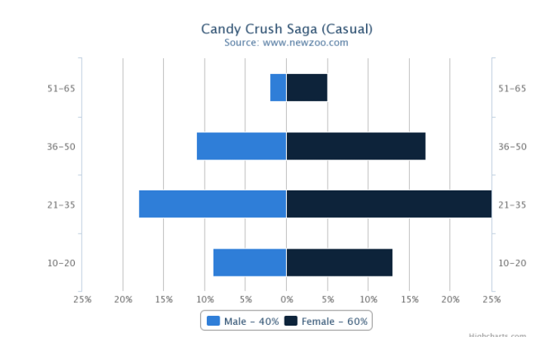
Target demographic
21 – 50 year old men and women
Short session time

Slide 4
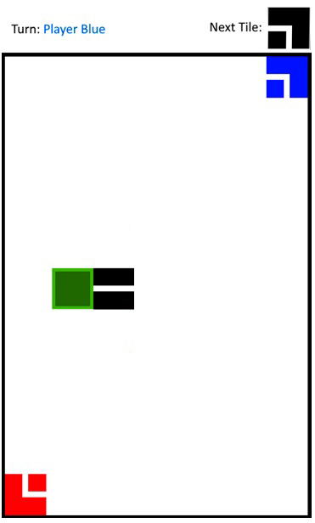
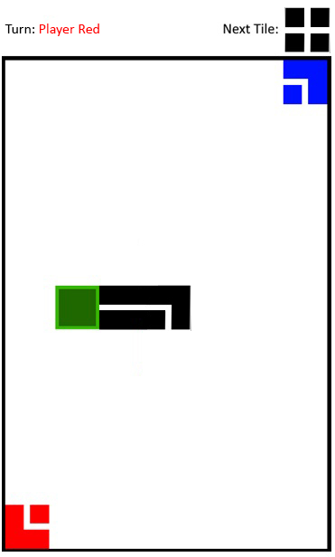
Mechanics
Players lay tiles in turns
Random tiles. Players only receive valid tiles
First to reach their color wins

Slide 5
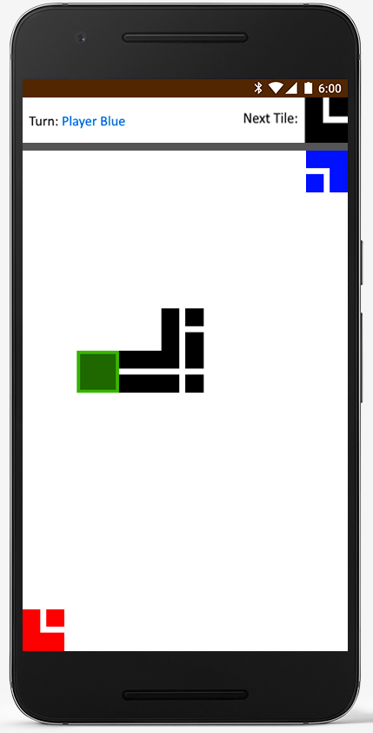
UI Breakdown
Turn tracker
The tile being placed
Starting position
Red player win condition

Slide 6
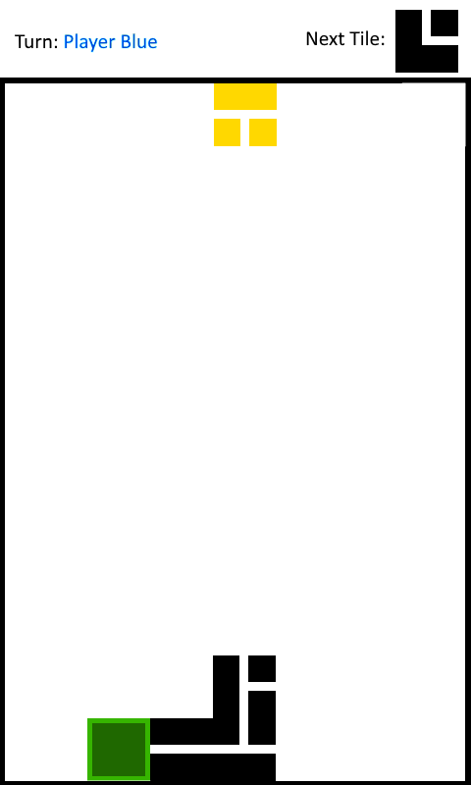
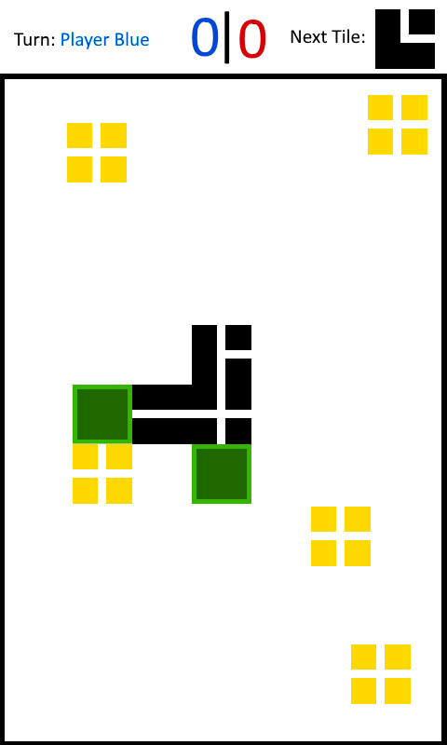
Concepts for Pipe Dream
Design and programming challenges
Win conditions

Slide 7
Programming
Unreal vs Unity
Blueprinting
Checking if the given tiles are valid
Checking if the placement is valid

Slide 8
Programming Challenges
Building the prototype
Possible work arounds
Notes:
Why you chose Unreal over Unity

Slide 9
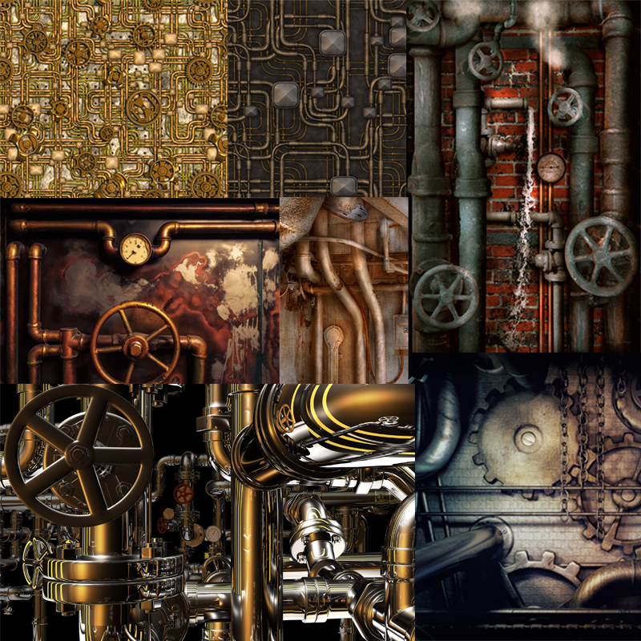
Design
Steampunk theme
Industrial theme
The challenges
Notes:
None of us can do art.

Slide 10
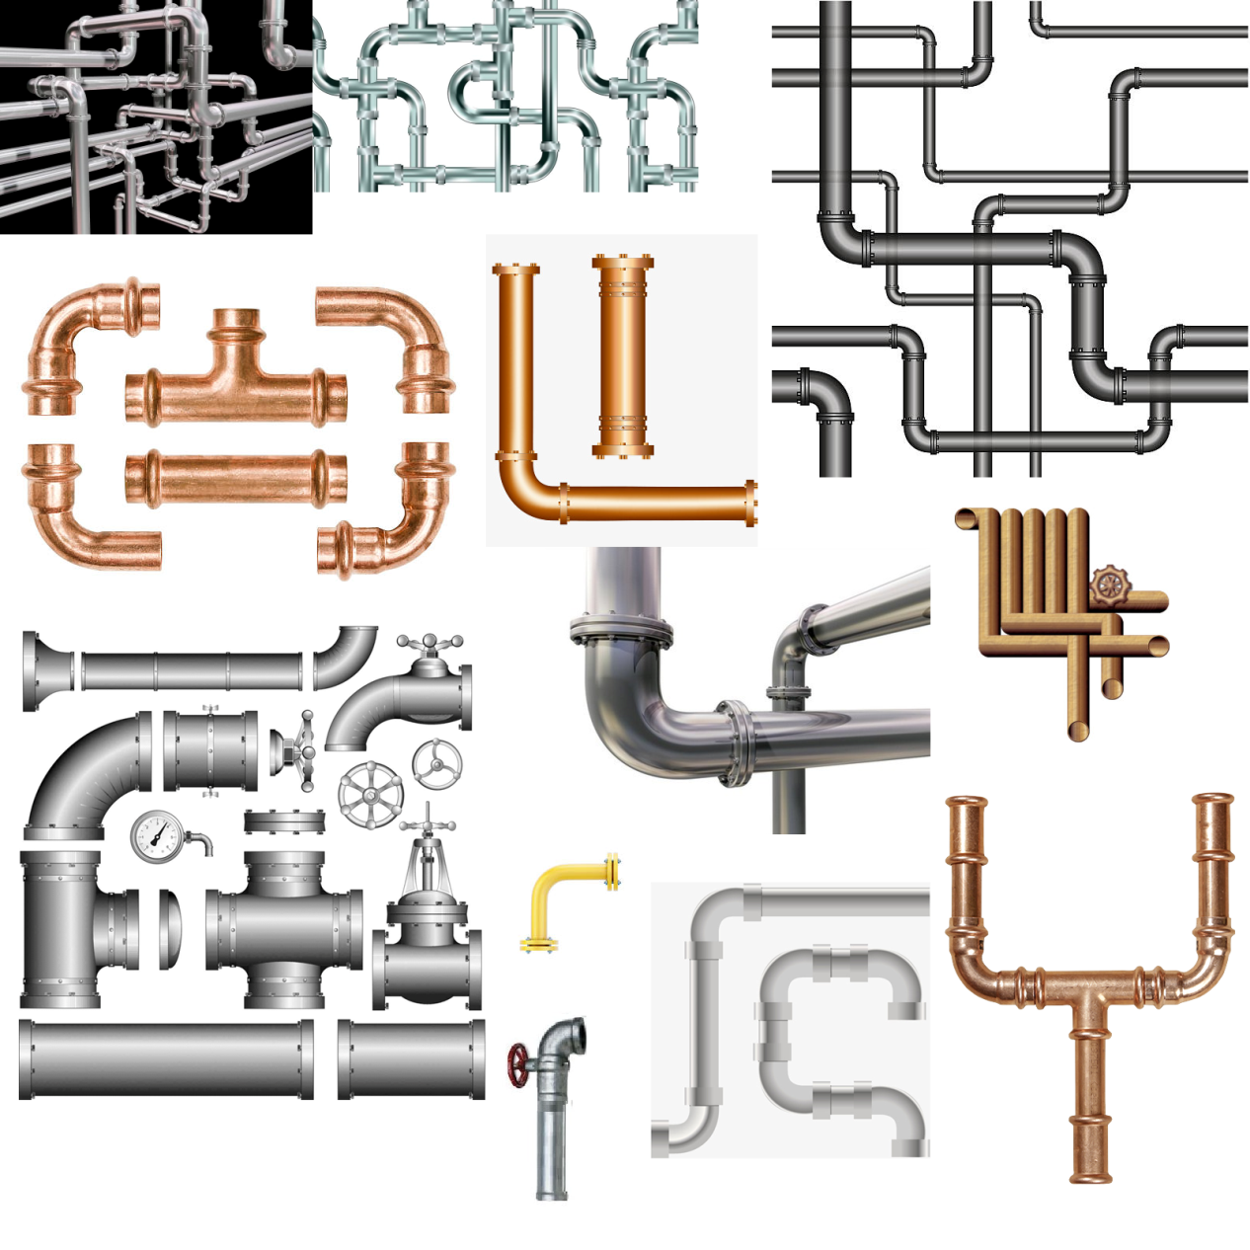
Moodboards
Signs
Feedback
Background design

Slide 11
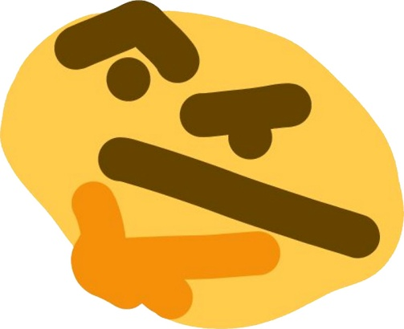
Any questions?

